Slide 1

Depreciation

Slide 2
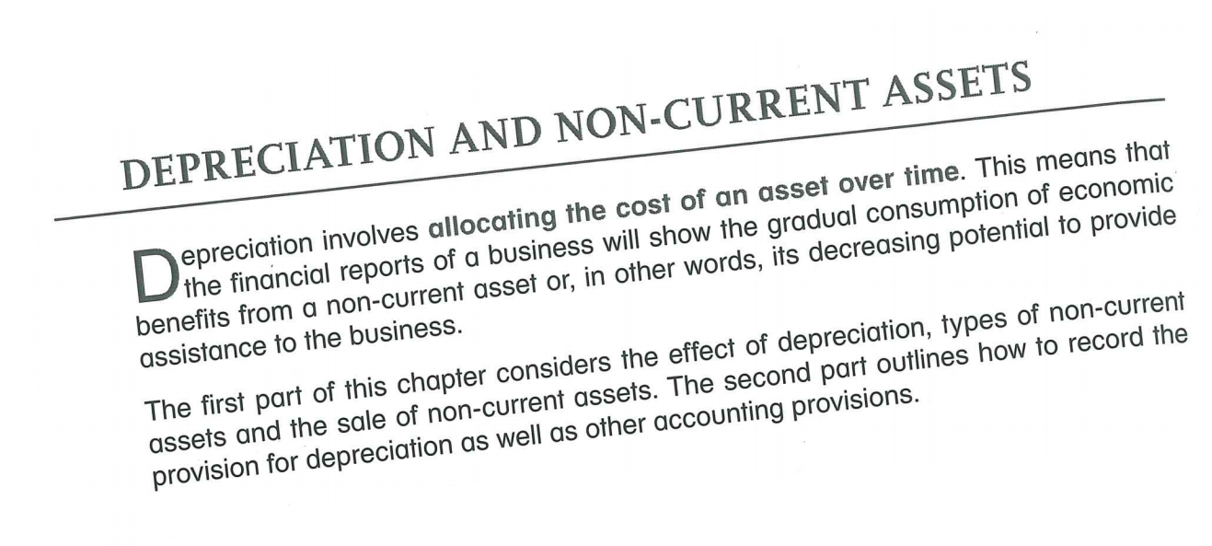

Depreciation: Definition, Formula & Examples - Video & Lesson Transcript | Study.com

Slide 3
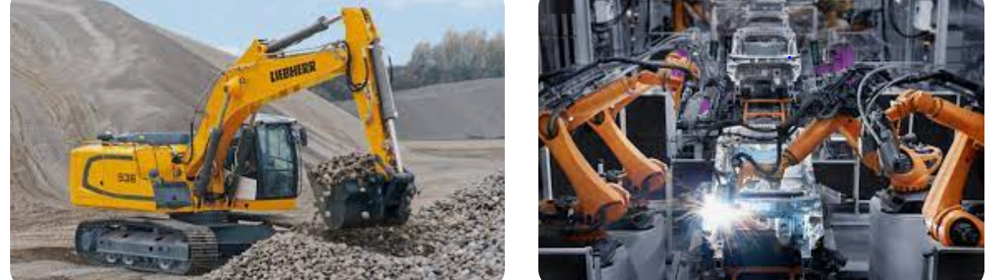
The Nature of Depreciation
Depreciation represents the consumption or loss of future economic benefits.
Depreciation is an expense to the business because it results in a gradual decrease in economic benefits provided by an asset.
Due to wear and tear, usage, obsolescence and perhaps legal limits, the asset ceases to provide the same amount of economic benefit and the depreciation expense accounts for this.

Slide 4

The Nature of a Depreciable Asset
A depreciable asset is expected to be used for more that one accounting period.
A depreciable asset is held for use in the production or supply of goods and services, for rental others or for administrative purposes.

Slide 5
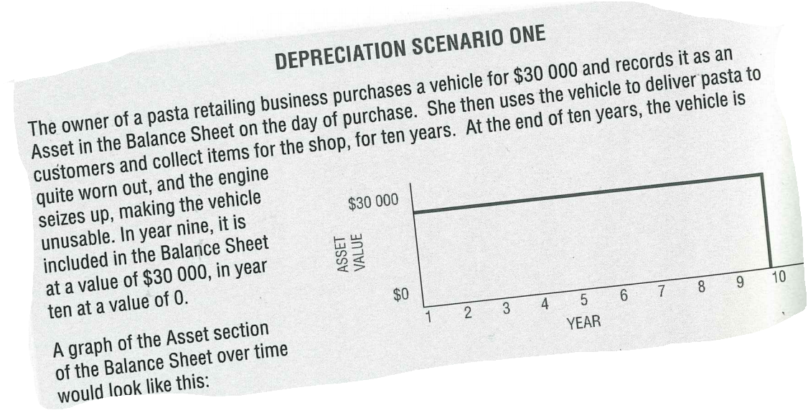


Slide 6
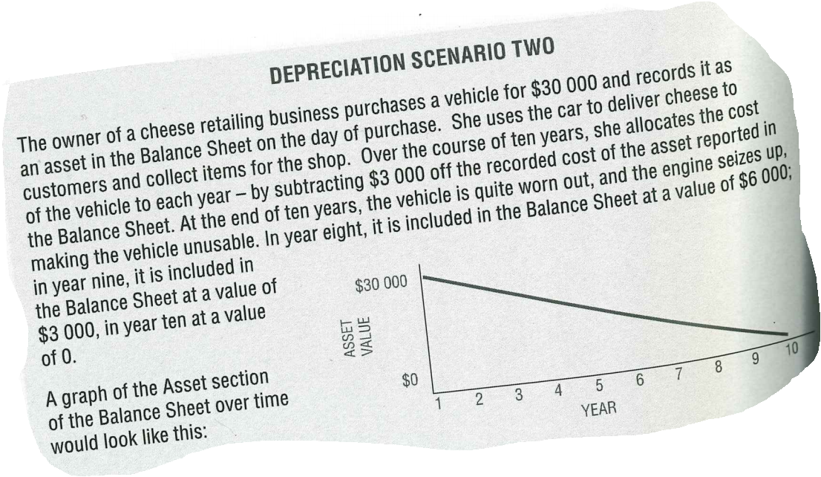

Slide 7
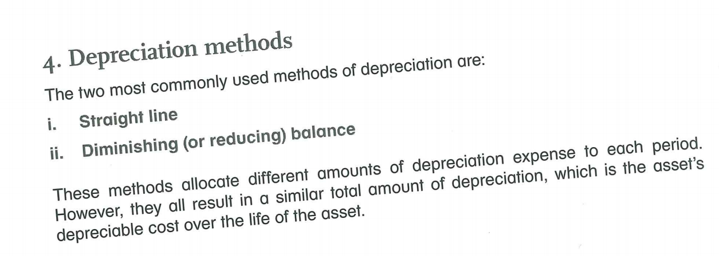


Slide 8
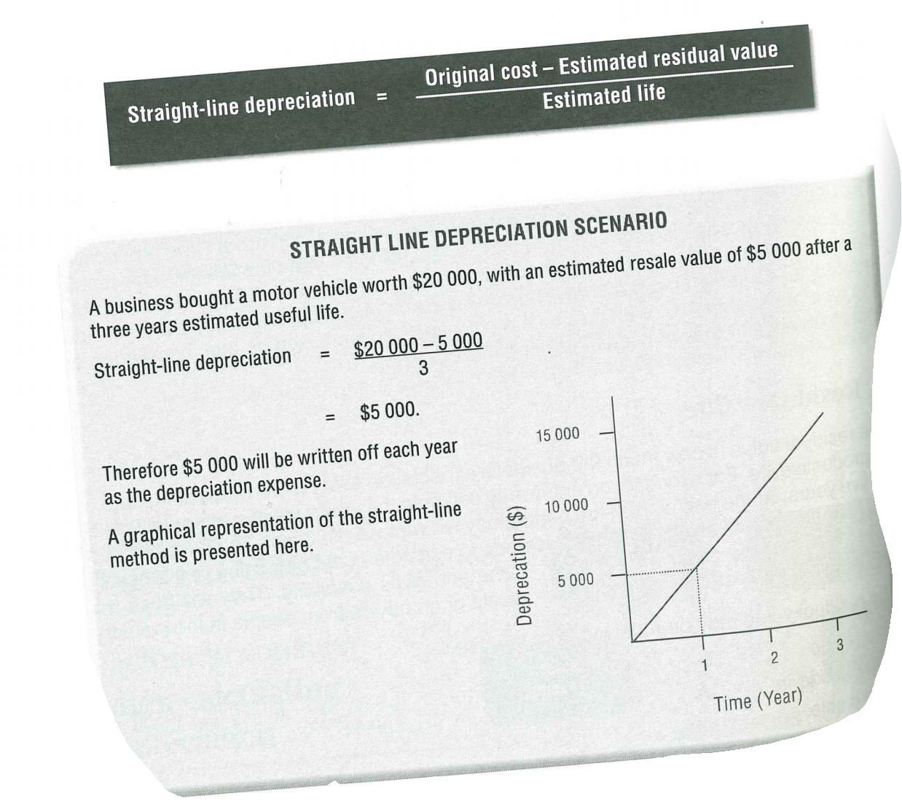
Year | Depreciation
1
2
3

Slide 9
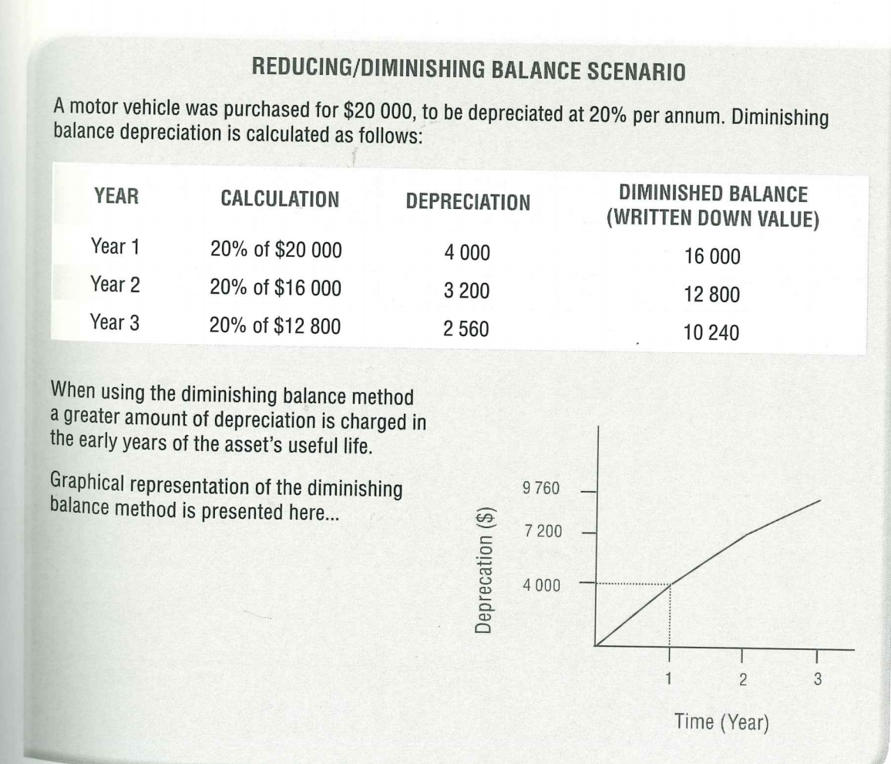
Year | Depreciation
1
2
3

Slide 10
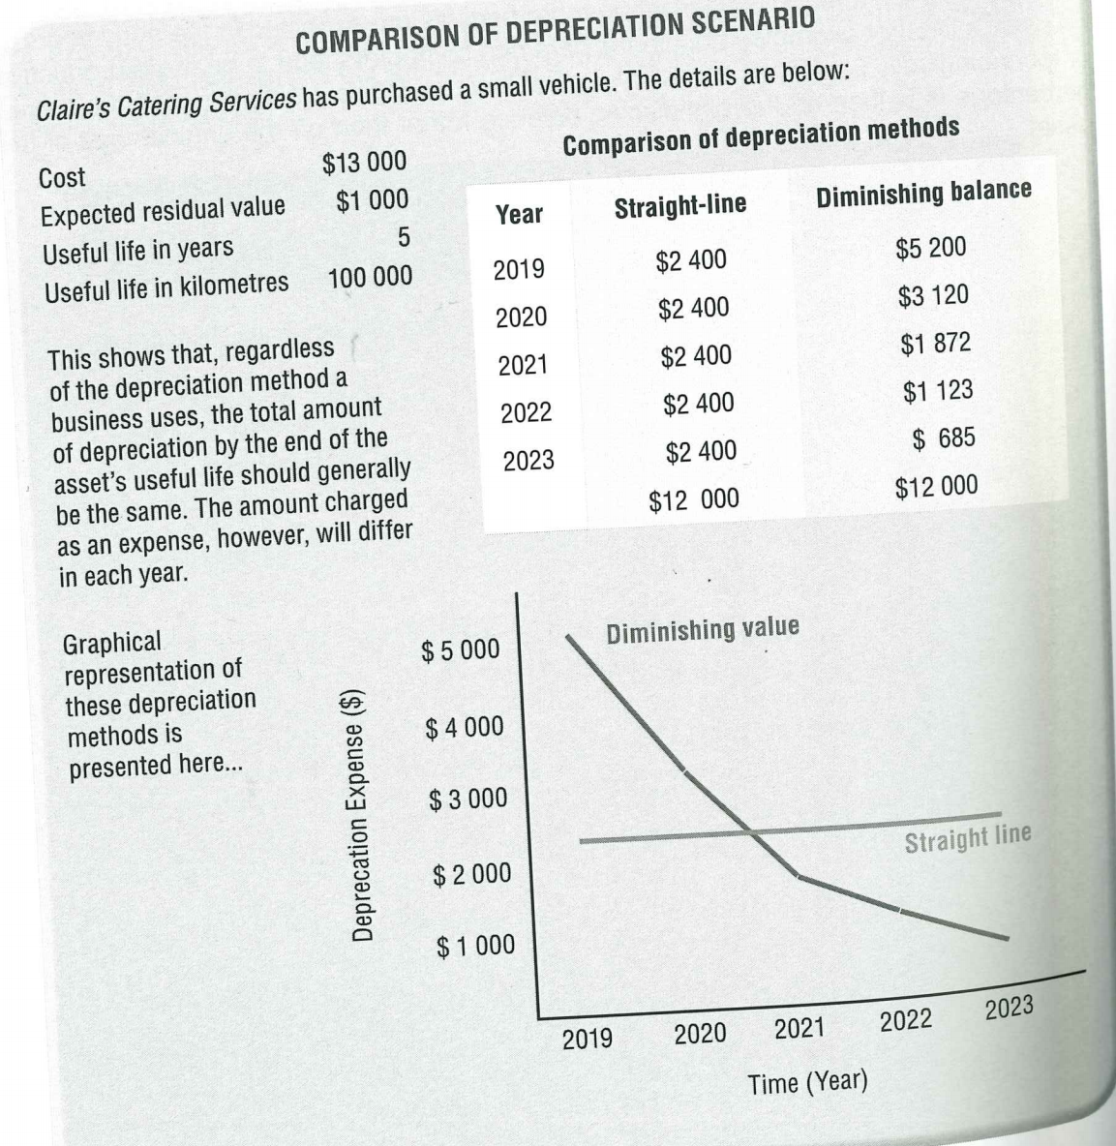
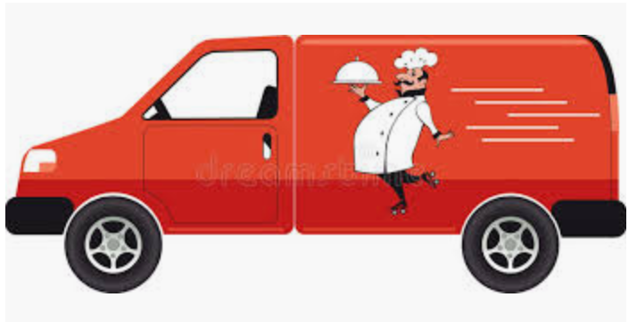

Slide 11
Task:
Draw a table comparing the straight line and reducing balance depreciation rates. Table how an asset valued at $10,000 would be depreciated using either of:
Straight line of $2 000 per year
Reducing balance of 20% per year

